Slide 1



Reuters Connect
Top Tips for Pictures

Slide 2
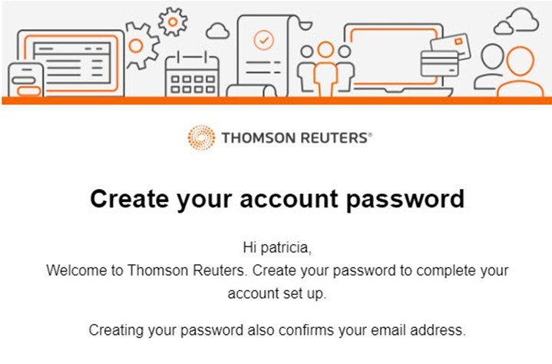
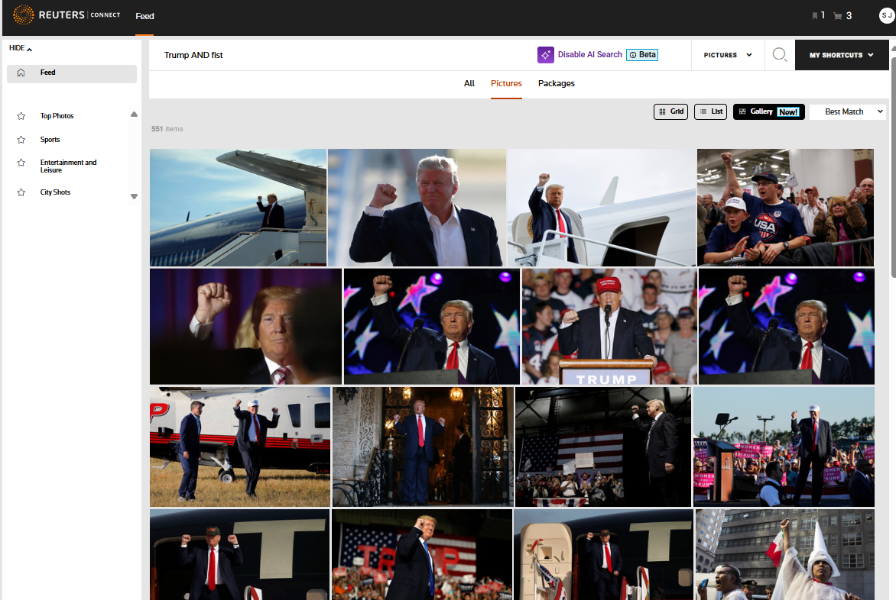
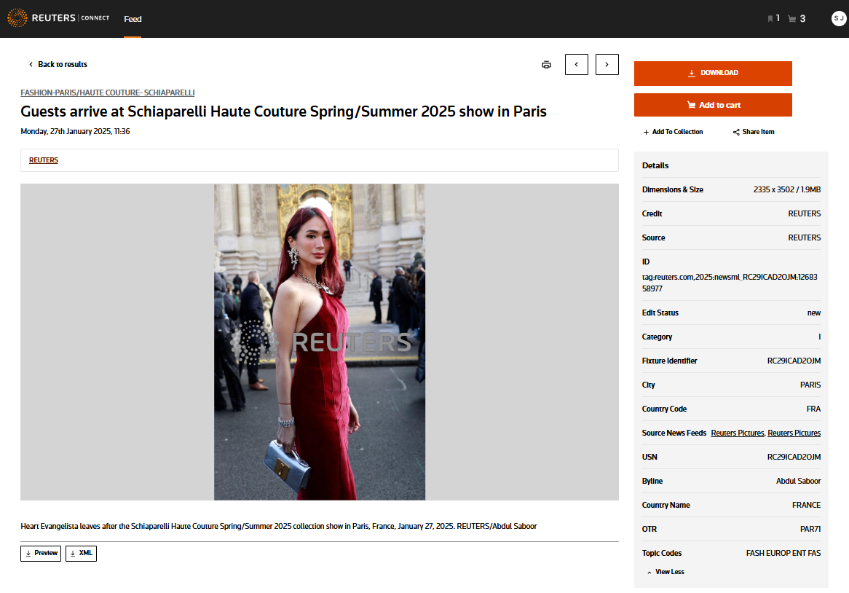
Reuters Connect is your one-stop destination for all your content needs
​An intuitive platform, built to streamline your editorial workflows. Learn how to make the most out of it:
Migration account access and password setup
Enhanced search features
Dive into the asset
Leverage our Search Bar to find content across All assets, Pictures, or Packages.
Enhance results with capitalized Boolean operators (AND, OR, NOT).
Use quotation marks for phrases.
Sort results by Newest First, Oldest First, or Best Match depending on your needs.
Try our BETA AI Search for natural language search, which sorts by Best Match.
Explore assets by clicking to view picture details, including source, date, dimensions, and metadata.
The features available include Download, Add to Cart, Add to Collection, and Share.
Find the asset ID, photographer details, and restrictions.
Leverage slugs (e.g., USA-CRIME/NEW YORK), topic code shortcut (e.g. TPX for Top Photos) and tags (e.g., CRIME) for quick links to related content.
As part of your account migration, your username will be your email address, and you will receive a password reset email from thomsonreuters.com.
This reset will be active for 2 days. If it expires, follow the steps illustrated here to reset your account and password.
Notes:
(These results are based on a keywords within the accompanying text to the images)

Slide 3
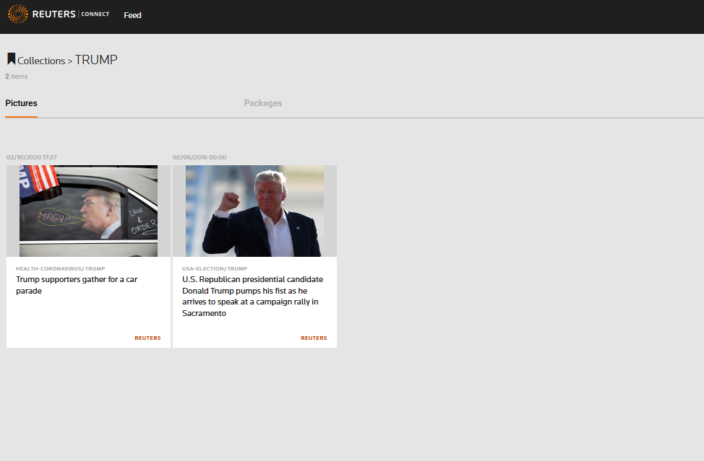
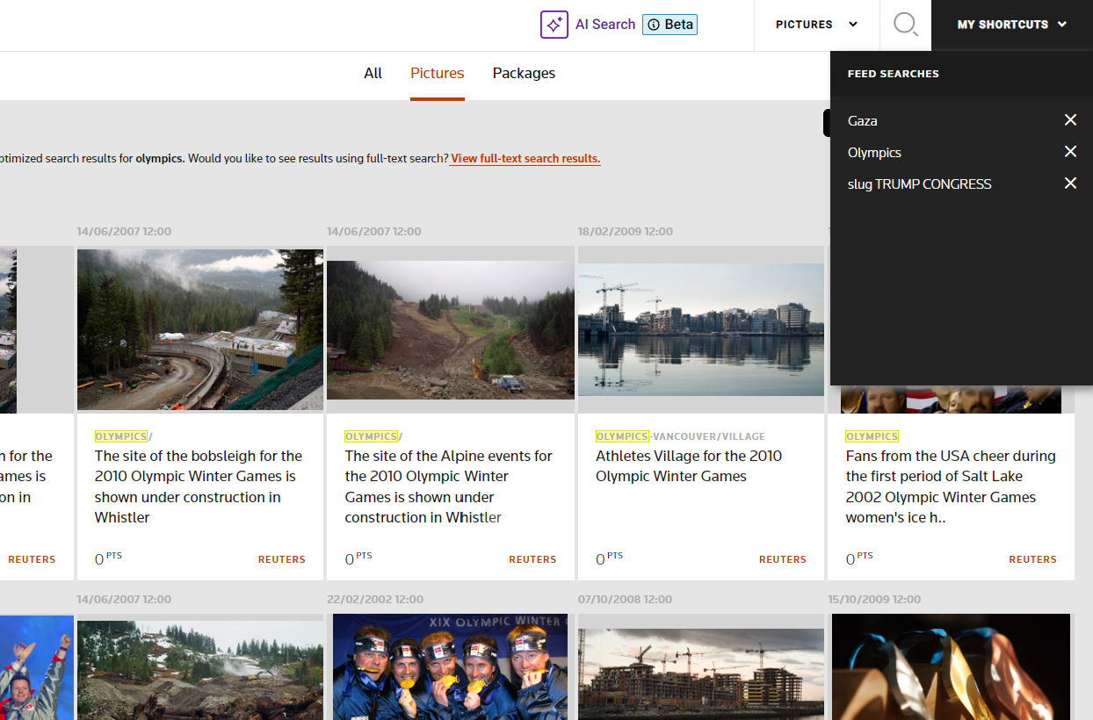
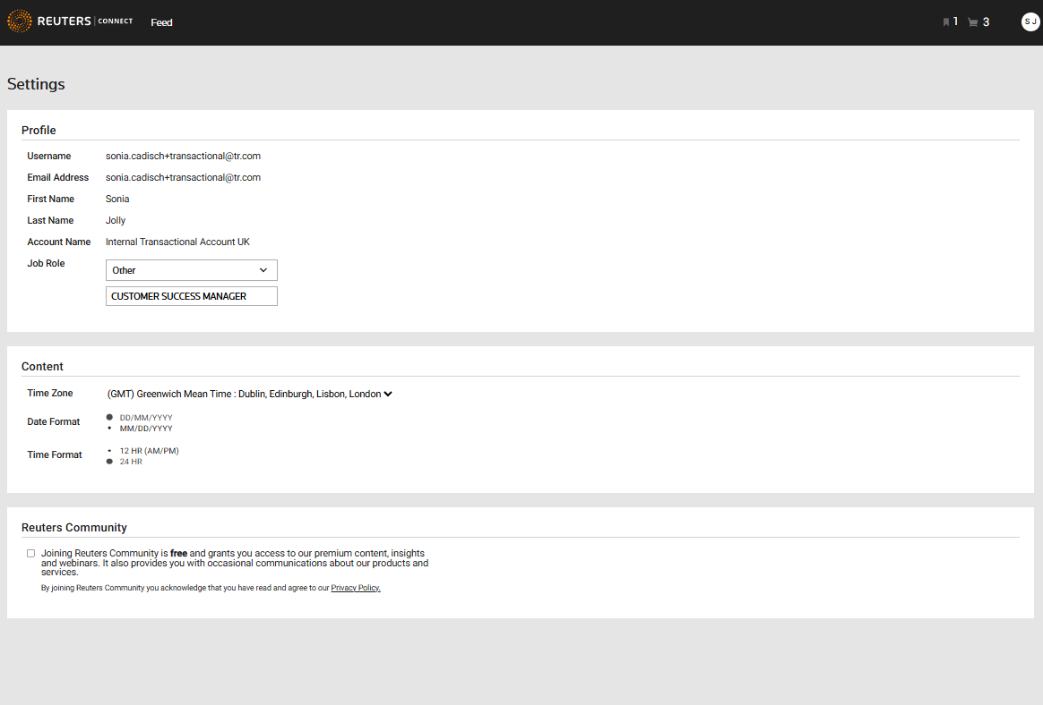
Reuters Connect is your one-stop destination for all your content needs
​An intuitive platform, built to streamline your editorial workflows. Learn how to make the most out of it:
Leverage collections
Save searches and set notifications
Explore your account page
Collections, previously known as lightboxes, enable you to easily compile key content, share it with colleagues, and quickly access and download assets.
Save searches and get notified of the content you need based on your frequently searches.
Create Shortcuts for frequently used searches to personalize your platform experience.
Get email alerts for new pictures related to your saved searches.
You can access your previous orders and downloads within the My Account page, where you can also view the Reuters license terms for your assets.
Notes:
(These results are based on a keywords within the accompanying text to the images)

Slide 4



Get even more value from Reuters Connect
LEVERAGE FILTERS
SEAMLESS CHECK-OUT
Use the Filter drop-down to refine results by Media Type, Category, Date, and Region, and view the number of assets available for each
Click Apply to see available assets
Click the cart icon to purchase pictures and packages
Set up a license and price for each item
Review your Checkout Summary and select the items proceed
Enter billing details and click Place your order
CUSTOMER SUPPORT
Our Chat feature provides 24/7 direct contact with our teams to assist with content, technical, and sales questions.
For billing account changes or tax-exempt inquiries, please contact your Account Manager at (reutersnewsagencysales@thomsonreuters.com) or support team through the chat.

